Slide 1
Applied Physics(C. Sc.) BS CS Semester-I Course Code: L-8(Heat and Temperature) IUB & All Affiliated Colleges. Reality Awards Boost Up (YT-Channel)
Rushmat Ali
Assistant Professor OF Physics
Govt. Kh. F. Graduate College R. Y. Khan

Slide 2
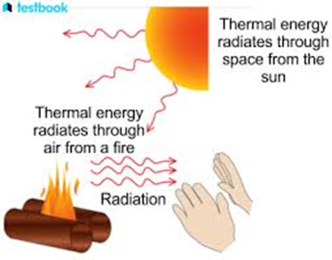
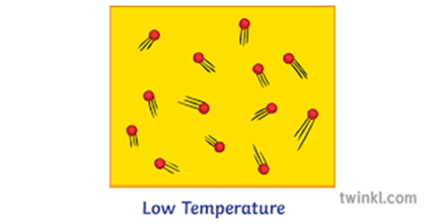
What is Heat?
Heat is a form of Energy which travels from high temperature to low temperature. It is also called Thermal Energy,
In Microscopic form, The total K. E. of all molecules constituting the body.
It is measure of how much a substance is hot or cool.
When heat is added to a system, its temperature increase and vice versa.
The sources of heat are: Sun, Burning of Fuel, Wood or organic substance.
It changes the state of matter: Solid to Liquid to Gas and vice versa.
It is measured in units of Energy i.e. Joules.
Special unit of heat is Calorie.

Slide 3
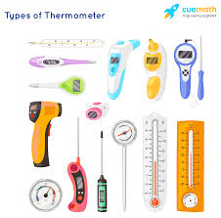
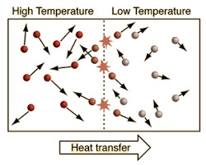
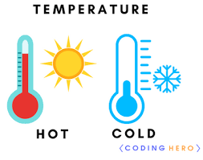
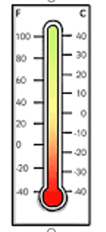

What is Temperature?
The degree of Hotness or coldness is called temperature.
In Microscopic Form, the average K. E. of molecules constituting the body is called Temperature.
It depends upon the motion of atoms, molecules or particles of the body.
It is a condition of a body which determines the transfer of heat from one to other body.
It has 3 temperature scales(Fahrenheit, Kelvin and Celcius)
It is fundamental Quantity but related to Base quantity.
It is measured in units: Kelvin(K), Celsius(C$°$), Fahrenheit(F$°$)

Slide 4
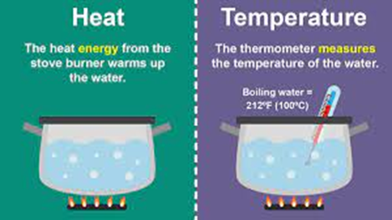
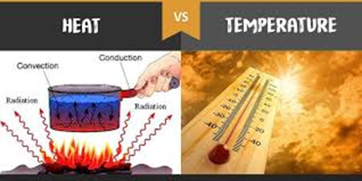


Difference between Heat and Temperature:
Heat:
It is form of energy, called Thermal energy.
It is denoted by Q or $∆Q$
It is a cause
It travels from high to low temperature.
It is derived quantity.
The total K.E. constituting the body.
Heat can not be measured directly from calorimeter.
Heat is measured in unit of energy.
S.I. Unit of Heat are Joules and other Units are Calorie, eV etc.
Temperature:
It is fundamental quantity.
It is denoted by T or t or $∆t$
Lt is an effect.
It is due to heat.
It is fundamental quantity.
The average K.E. of the body constituting the body.
It can be directly measured by thermometer.
S.I Unit is kelvin(K) and other units are Celsius ( C$°$) & Fahrenheit(F$°$)

Slide 5
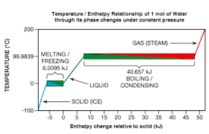
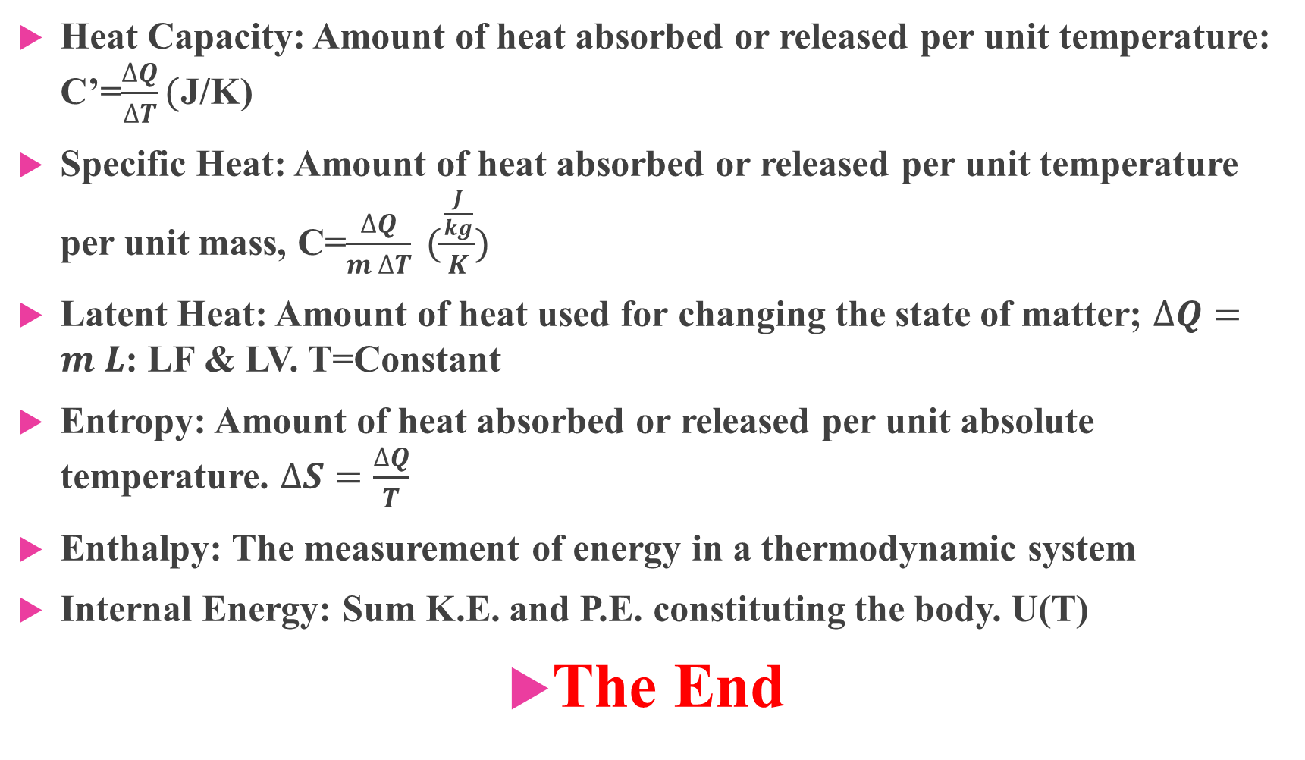
Relation between Heat and Temperature:
Heat Capacity: Amount of heat absorbed or released per unit temperature: C’=$\frac{∆Q}{∆T}($J/K)
Specific Heat: Amount of heat absorbed or released per unit temperature per unit mass, C=$\frac{∆Q}{m ∆T} (\frac{\frac{J}{kg}}{K})$
Latent Heat: Amount of heat used for changing the state of matter; $∆Q=m L$: LF & LV. T=Constant
Entropy: Amount of heat absorbed or released per unit absolute temperature. $∆S=\frac{∆Q}{T}$
Enthalpy: The measurement of energy in a thermodynamic system
Internal Energy: Sum K.E. and P.E. constituting the body. U(T)
The End

